Slide 1
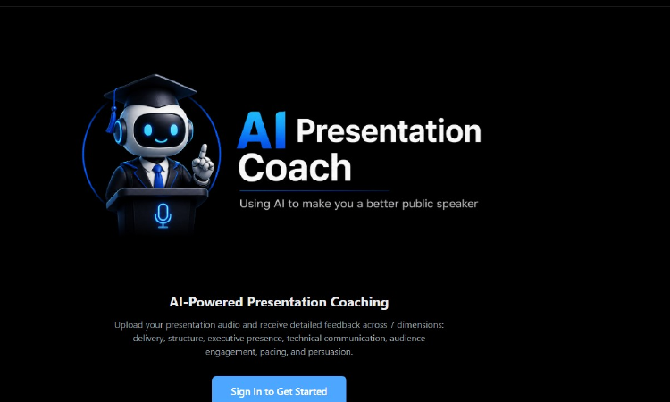
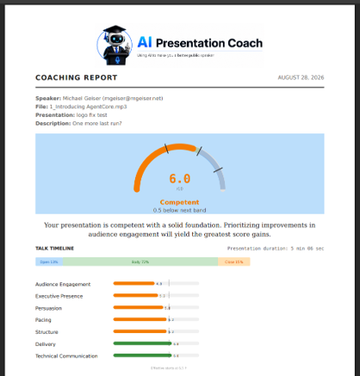
AI Presentation Coach
Using AI to make you a better public speaker
An AWS-native event based agentic presentation coaching platform built with Kiro and AI-DLC practices.
This is not just a demo, it is a useful pattern for taking agentic systems from idea to PoC to Production via governed software delivery.
Created and developed by Michael Geiser
AWS-native
serverless + agentic
Built for
zero idle cost
Dark theme retained from the working deck

Slide 2
EXECUTIVE LENS
The CTO readout
The AI Presentation Coach (“PresCoach”) is a working AWS-native product pattern, not a lab experiment. It accepts audio, prepares it, then hands it to independent Agentic AI evaluators that produce a coaching report.
Architecture decision
worth a CTO review
7
20+
>900
$33.69
Where to harden
before real users
AI coaching dimensions
AWS native
services used
Tests through all workflows
Spend for environment
and AI tools used
($6.59 AWS + $27.10 Kiro)
How to scale
without cost traps
What AI-DLC
actually changed
Source deck reported development cost; project overview and retrospective supplied architecture, services, test count, and operating model.
Notes:
Check the number of tests…

Slide 3
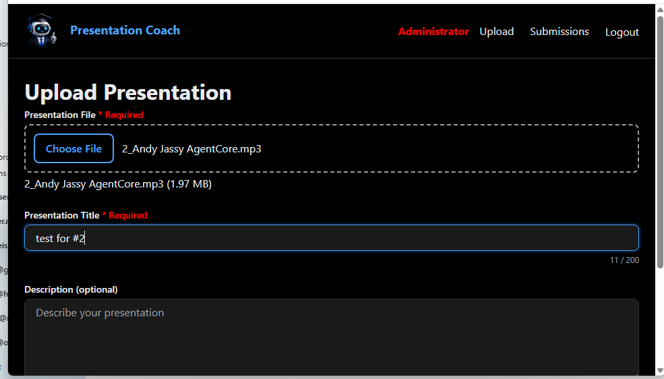
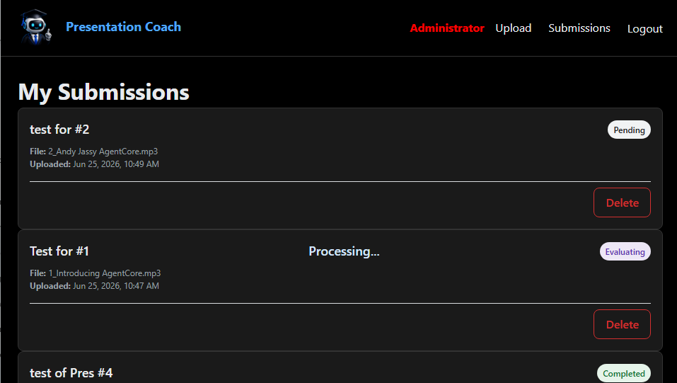
WHAT IT DOES
Using the product is simple, the system behind it is not
Upload
mp3, wav, m4a, aac
Prepare
transcribe + chunk + embed
Evaluate with
seven agent lenses
Report
PDF coaching output
The deliberate split: deterministic processing does the mechanical work, while the probabilistic agentic layer handles judgment. That separation is what makes the design easier to govern.
Let’s Deep Dive into the App UI Frontend & Backend, processing, and Agentic layers and then review the AI-DLC behind it.
User-facing flow
Accepted audio formats and video flag behavior come from the end-to-end processing flow.

Slide 4
The Web App

Slide 5
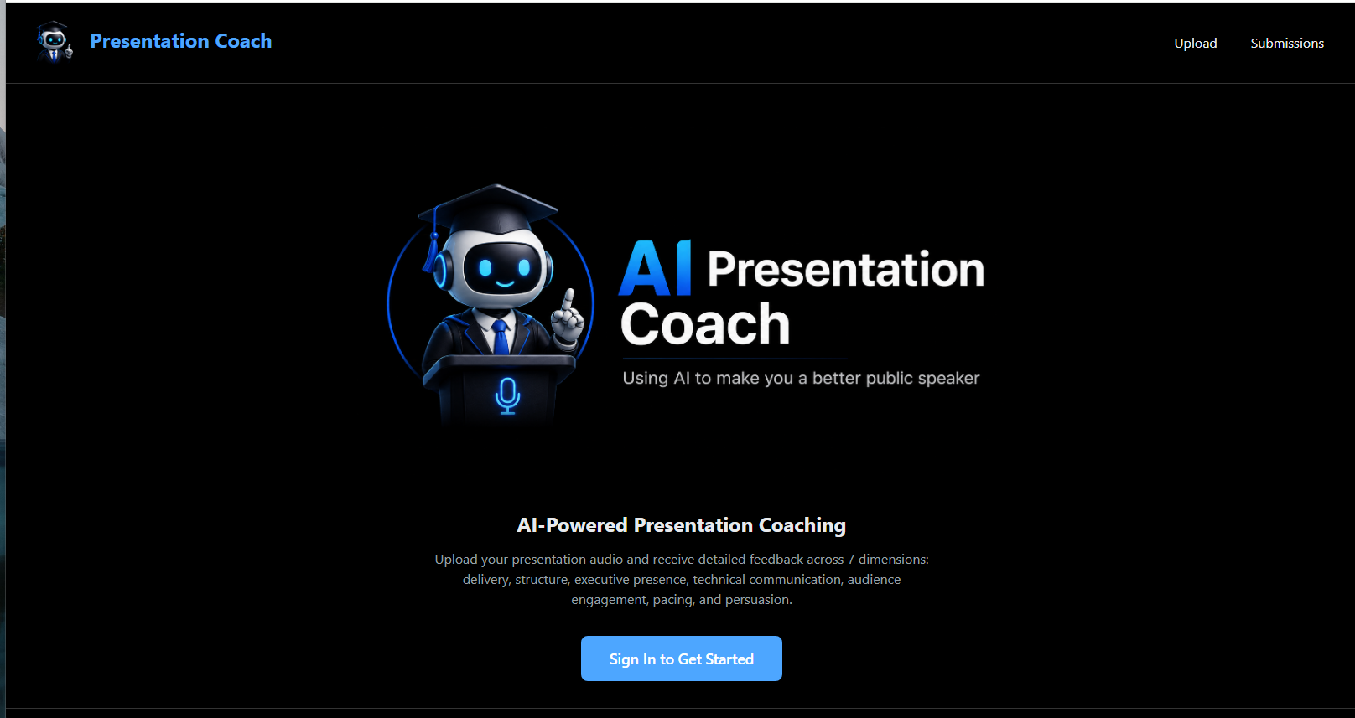
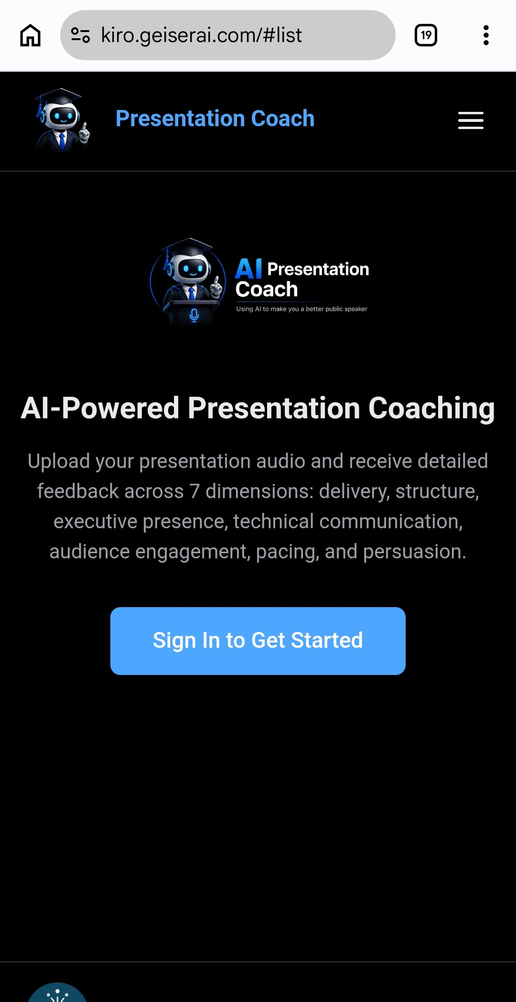
Responsive Web App
Web
Mobile

Slide 6
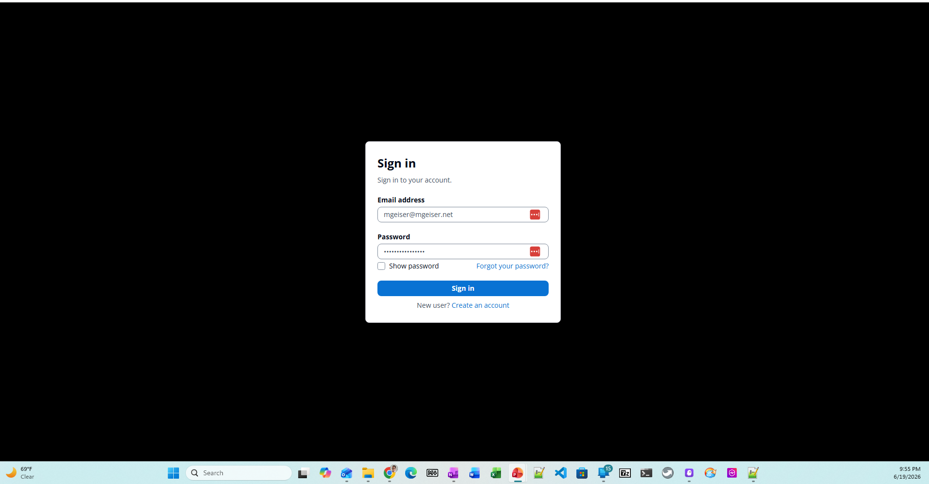
Cognito Based User IAM
Groups to define role
Users
Administrators
Other Cognito Functions
User self signup
Password reset
Password recovery
MFA (not turned on yet)
Managed Service
No Infrastructure or services to admin
No code to write or maintain
No cost for under 50,000 users
All IAM functionality, including MFA, is a no-cost managed service

Slide 7
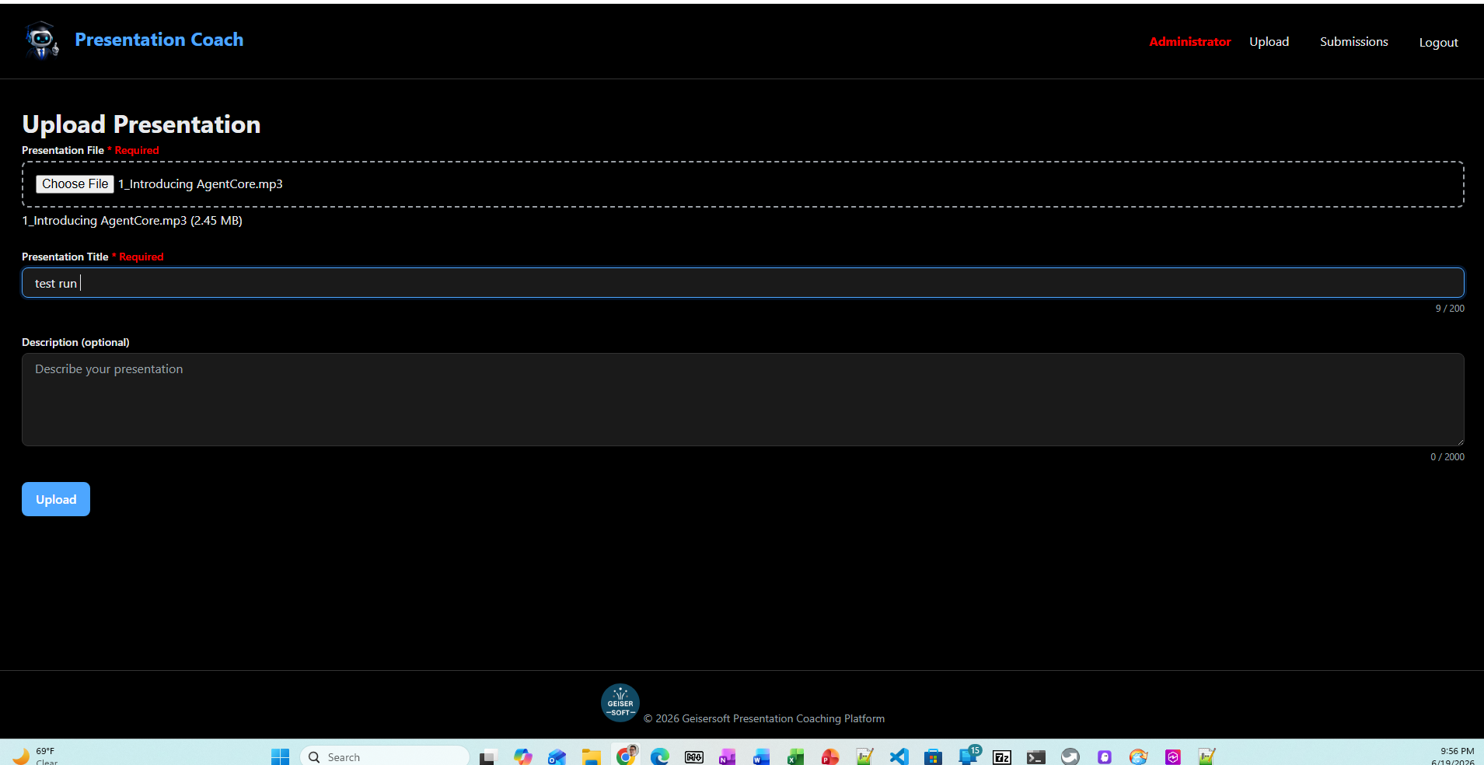
Audio File Upload
Features
File picker
Title
Description
Video File upload on roadmap

Slide 8
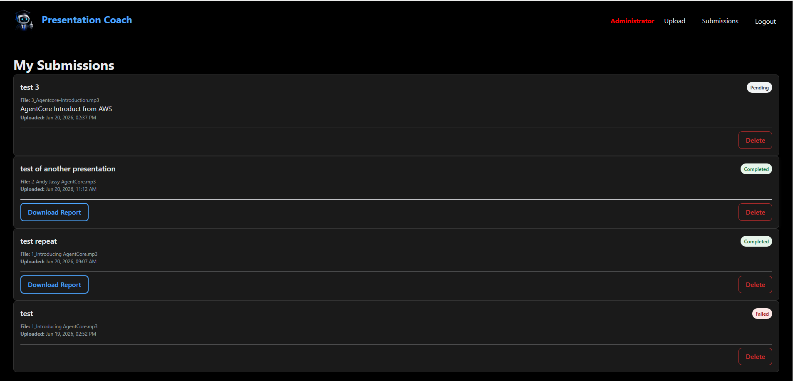
Processing
Features
Multiple steps
Realtime User status updates

Slide 9
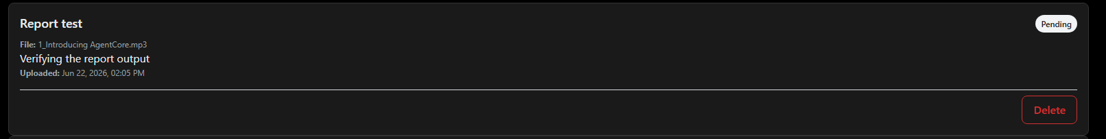
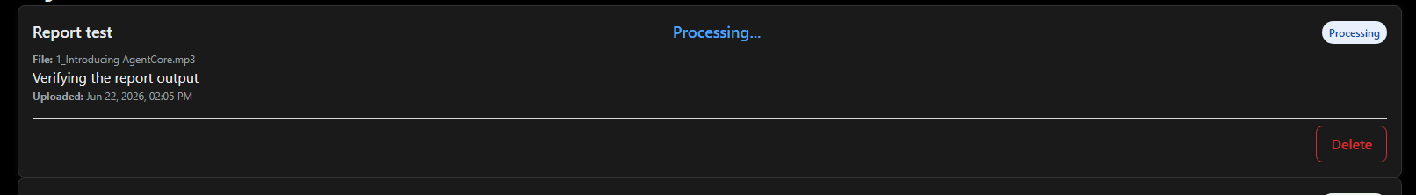
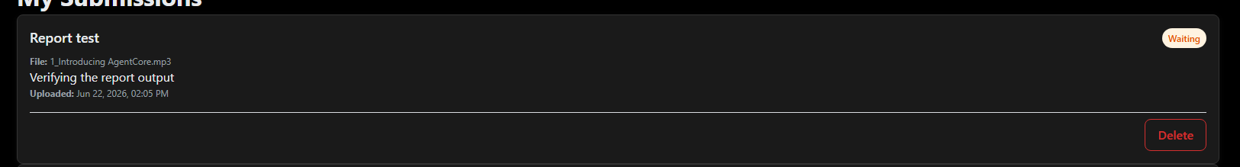
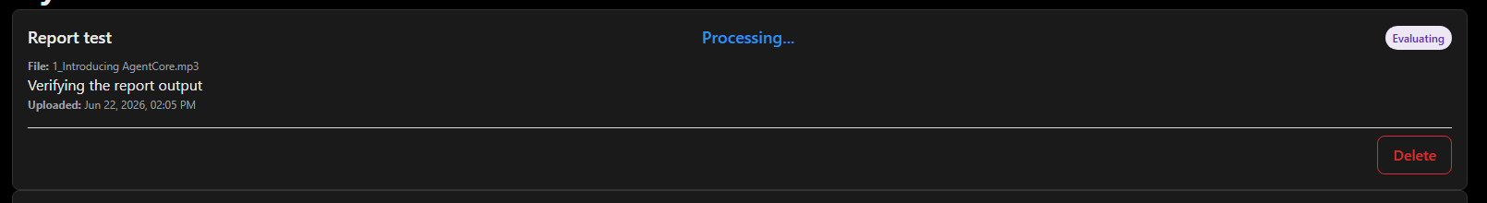
Statuses
Start of Presentation Coach Process
Pending: User uploaded unprocessed audio file
Processing: Transcription and prep
Waiting: Queued for Agentic Evaluation
Evaluation: Agentic analysis in progress

Slide 10
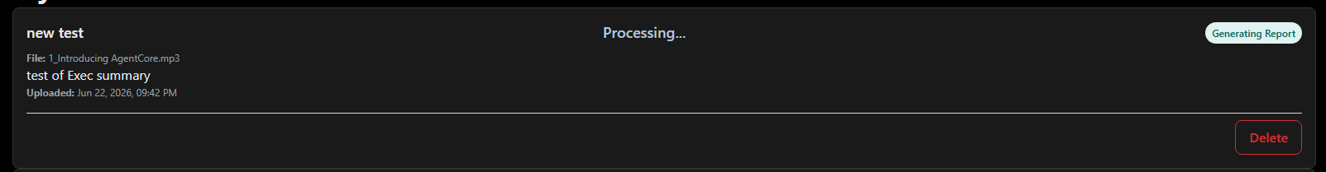
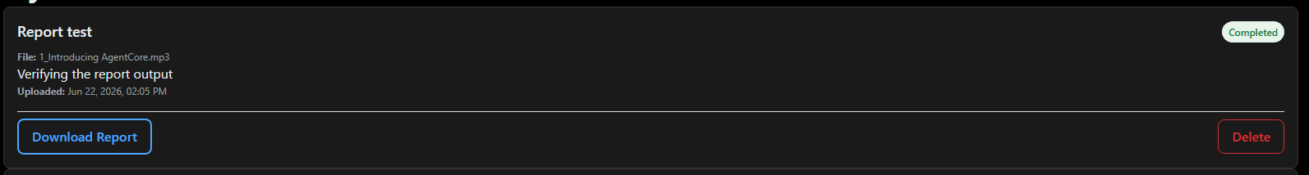
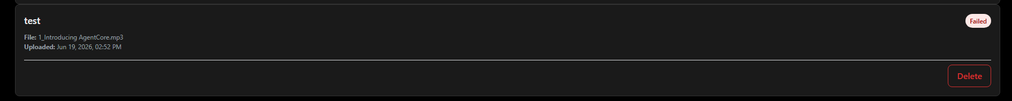
Statuses
Generating Report: Final report is being created
Completed: Report is ready for download
End of “Happy Path” Presentation Coach Process
Failed: An error has halted processing

Slide 11
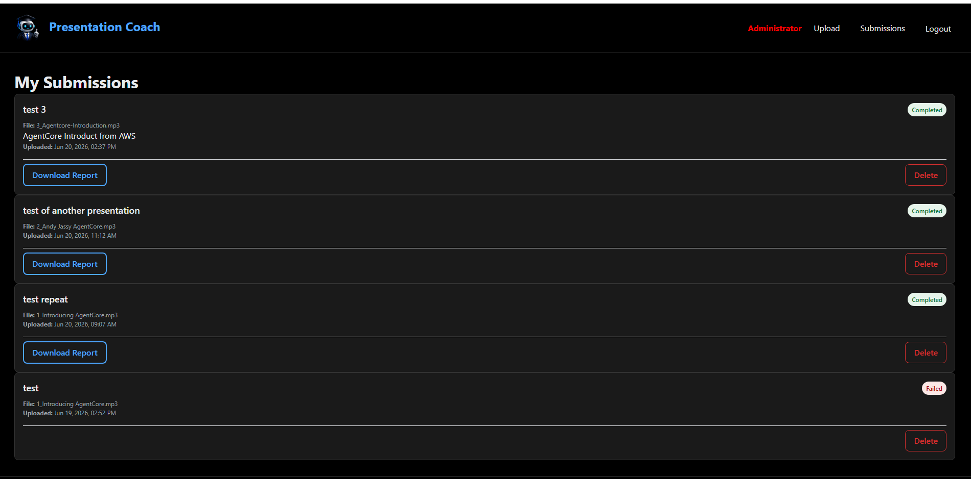
Report is Ready to Read
Features
Current status of analysis
Data entered by User displayed
Download report link
Delete link
Notes:
After completed and will report is being created, the My Submissions page throws a 500 error

Slide 12
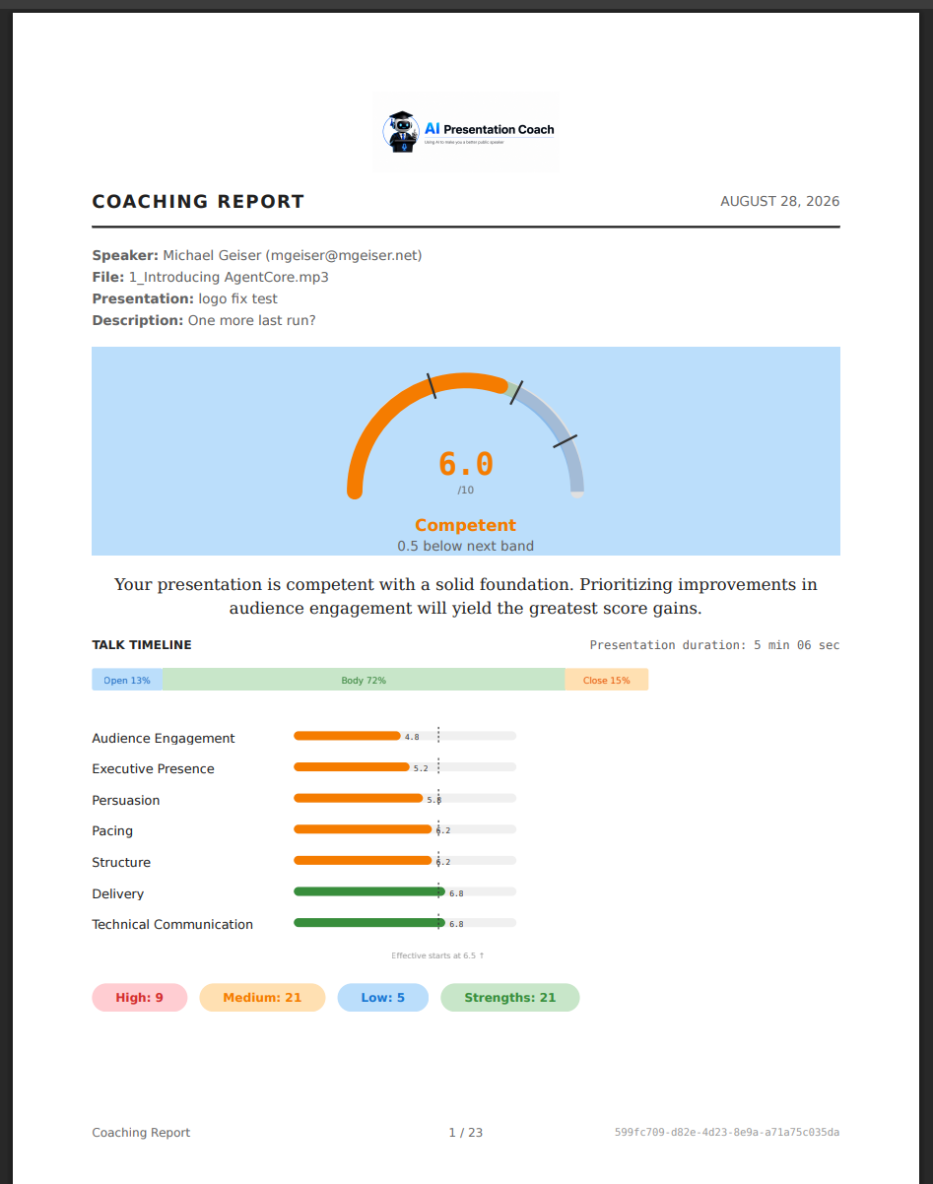


Slide 13
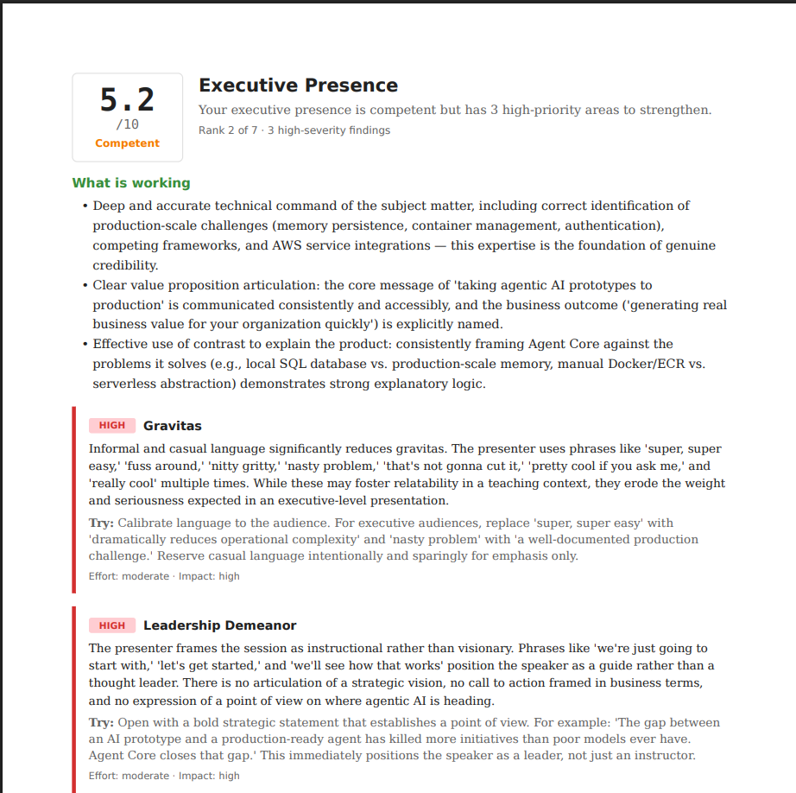
The Presentation Coaching Report
Features
Detailed feedback across 7 dimensions:
Delivery
Structure
Executive presence
Technical communication
Audience engagement
Pacing
Persuasion
Draft: Report format will be worked on during 60-day Path to Production.

Slide 14
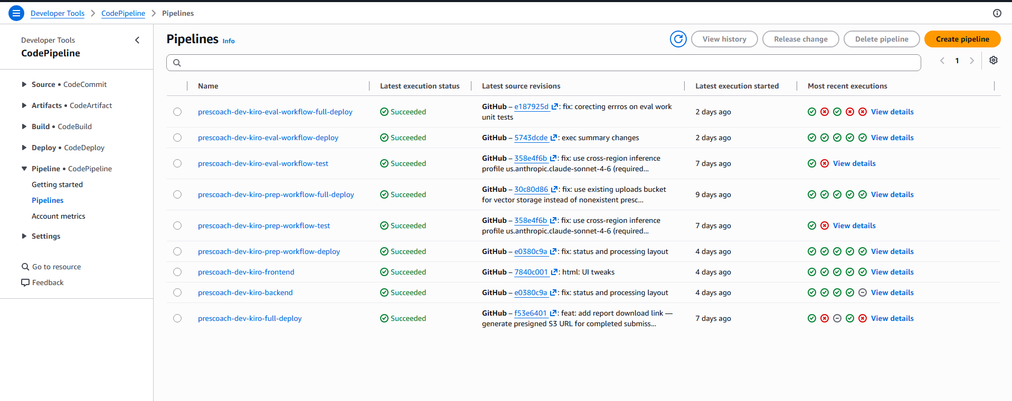
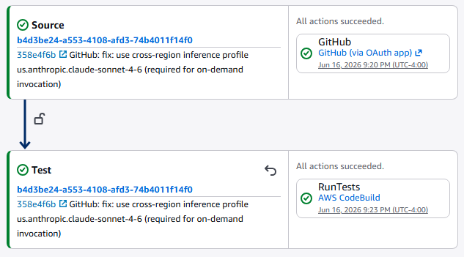
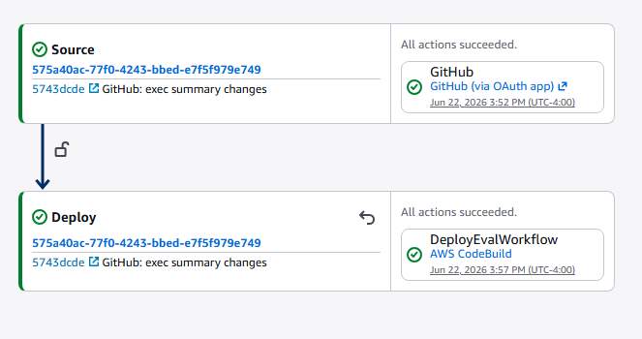
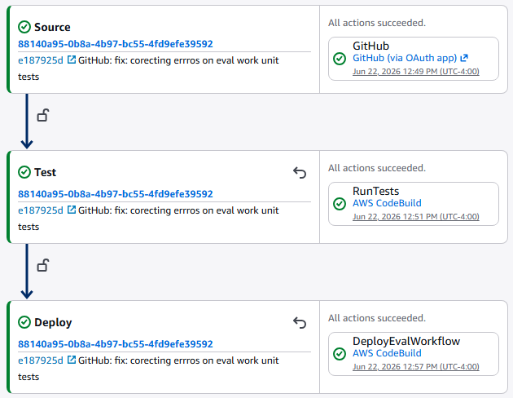
CI/CD Pipelines
CICD Pipelines pull from Github and allow deploys at multiple logical unit levels:
Frontend/Backend
Audio/Video Processing
Agentic AI Evaluation
Each Pipeline can deploy
Tests only (“test”)
Code only (“deploy”)
Tests & code (“full-deploy”)

Slide 15
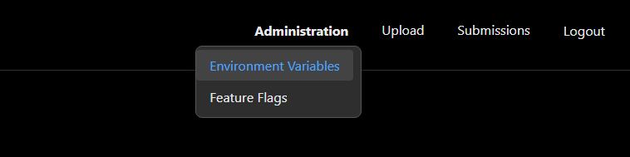
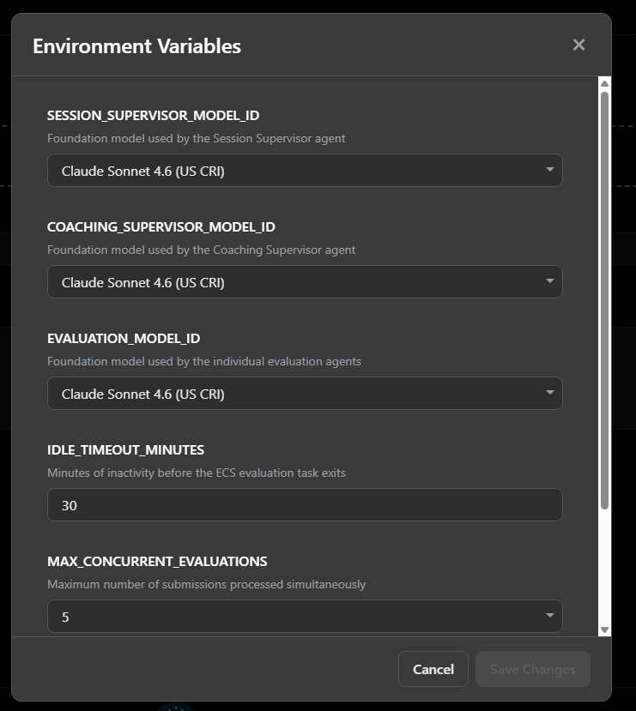
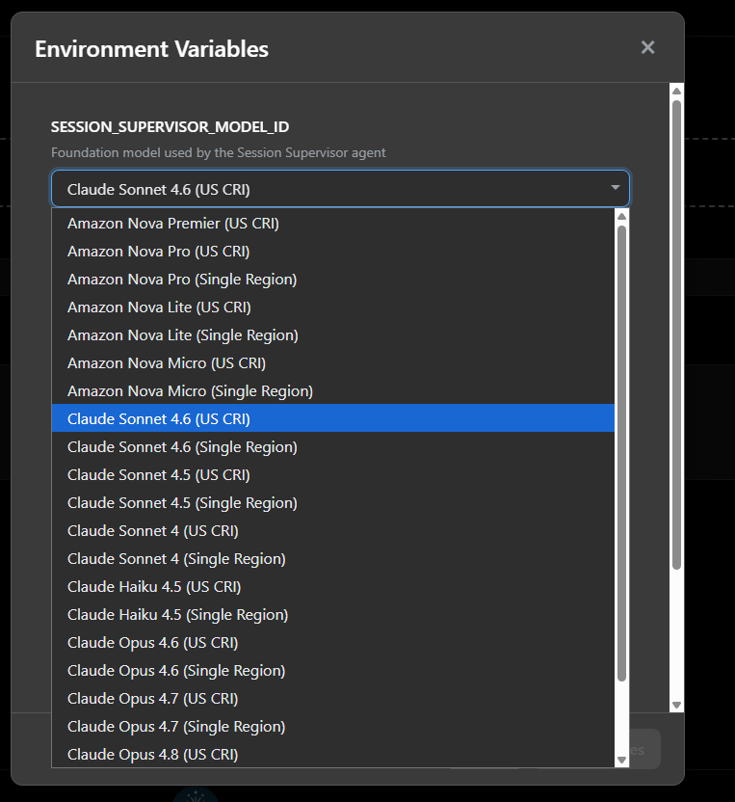
Administration – Environment Variables
“Adminitration” menu only available to users with Administrator role in Amazon Cognito.
Features
Full control over all environment variables
Models used
Idle timeout for ECS tasks
AI Concurrency limits
IAM settings
App designed as single tenant but multi-tenant was considered in design
Tested and approved models only are allowed to be selected for the app.

Slide 16
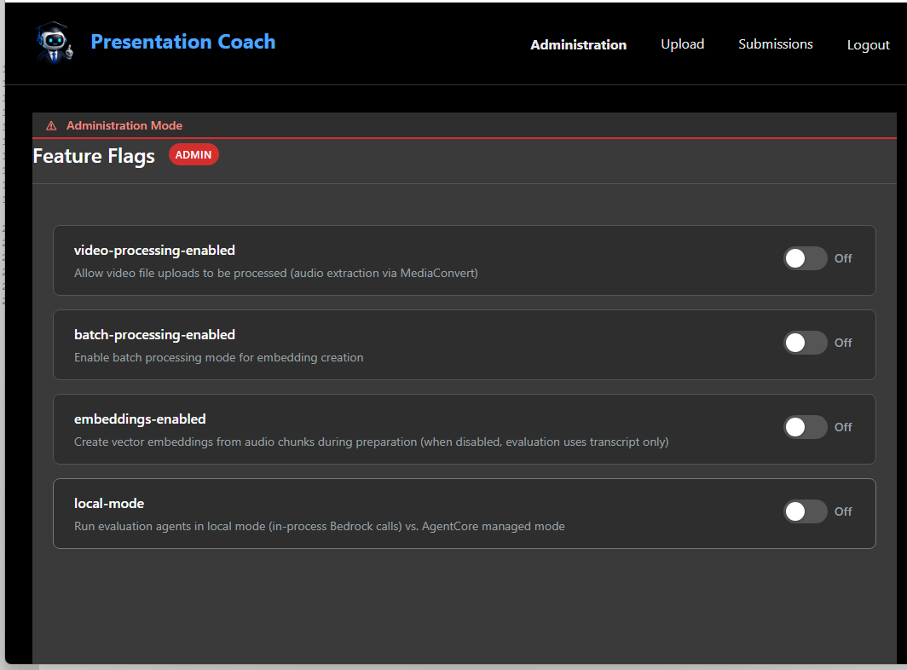
Administration – Feature Flags
Features
Full control over Feature Flagged scope:
Video Processing: User could upload video files to be processed in addition to audio files
Batch Processing: Batch processing allows for lower cost asynchronous processing of presentations for vector stores.
Embeddings: turns on and off vectorization of presentations.
Local Mode: using a simplified (less resilient) agentic processing implementation

Slide 17
Observability and Monitoring – (eta: Aug 15, 2026)

Slide 18
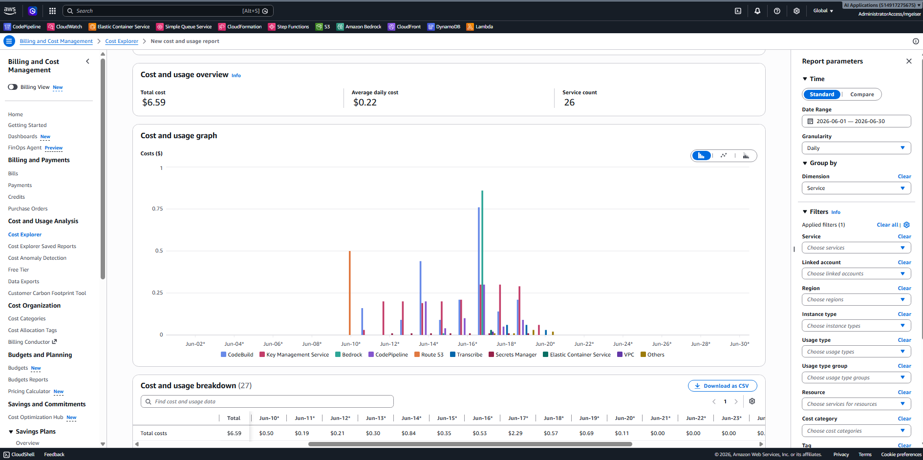

Development Costs
Features
Total costs of the development
AWS Account: $6.59
Kiro AI-DLC: 1355 Credits ($27.10)
LLM usage was not included in these costs. They usually show up each day but were delayed in June.

Slide 19
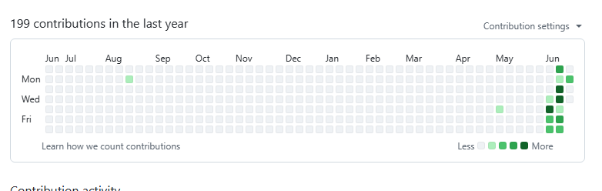
Github Repo Activity
Initial Build
https://github.com/michaelgeiser/kiro-agentcore-app

Slide 20
The Architecture

Slide 21
Web App SPA and Backend Architecture
us-east-1
VPC
Cognito
API
Gateway
Interface VPC
Endpoint
HTTP API
Traffic
WAF
SPA Web
Traffic
CloudFront
S3
DynamoDB
S3
WAF
SNS
Transcribe
CloudFront
SQS
Bedrock
API Gateway
Step Function
VPC Endpoint &
VPC Links

Slide 22
Audio File Preparation Architecture
us-east-1
VPC
Cognito
Amazon Transcribe
Amazon Bedrock
API
Gateway
Eventbridge Pipes
Interface VPC
Endpoint
HTTP API
Traffic
WAF
SPA Web
Traffic
CloudFront
S3
DynamoDB
S3
WAF
SNS
Transcribe
CloudFront
SQS
Bedrock
API Gateway
Step Function
VPC Endpoint &
VPC Links

Slide 23
Evaluation with Agentic AI and Report Creation
us-east-1
VPC
Bedrock AgentCore
Amazon Transcribe
Amazon Bedrock
ReAct Loop
Cognito
Evaluation Agents
Delivery Agent
Structure Agent
Executive Presence Agent
Supervisor Agent
Tech. Communication Agent
Audience Engagement Agent
Eventbridge Pipes
Eventbridge Pipes
ECS
Pacing Agent
API
Gateway
Persuasion Agent
Interface VPC
Endpoint
Summary Creation
HTTP API
Traffic
WAF
SPA Web
Traffic
CloudFront
S3
DynamoDB
S3
WAF
SNS
Transcribe
CloudFront
SQS
Bedrock
Option: Replacing EventBridge Pipes with Lambdas can be explored
API Gateway
Step Function
VPC Endpoint &
VPC Links

Slide 24
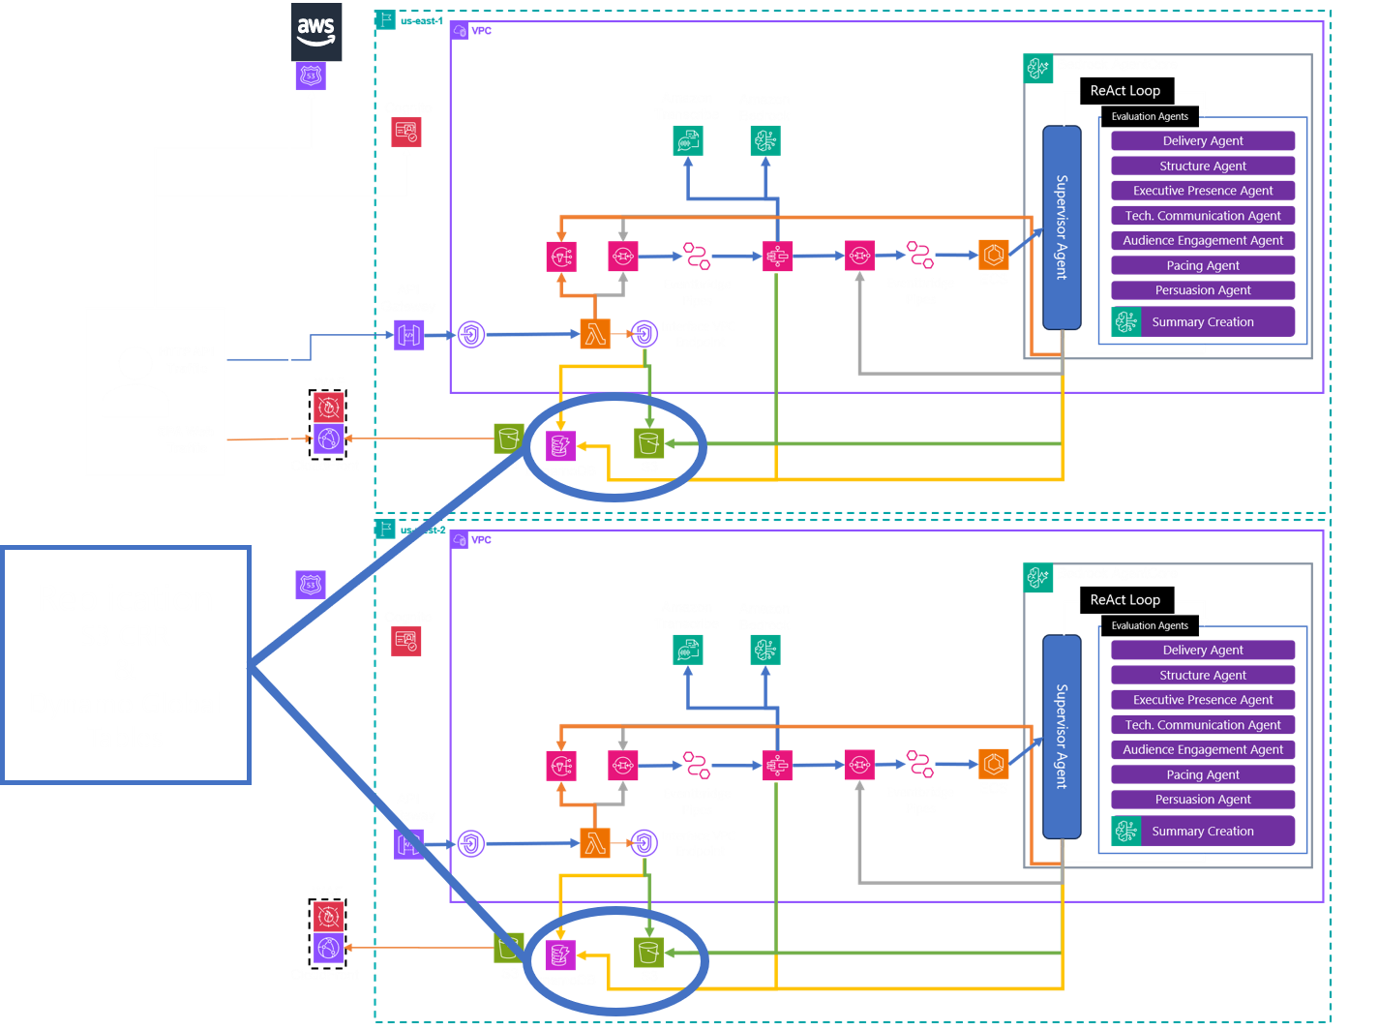
Multi-Region Ready if the Business Case Exits

Slide 25
DELIVERY MODEL
Build approach: AI-DLC turned the idea into deployable work units
The useful lesson is not that code was generated quickly. The useful lesson is that the work was decomposed into independently testable “bolts” with clear contracts.
Frontend SPA
Upload & Storage
Preparation Workflow
Agentic Evaluation
Auth, upload UX, responsive web app
Presigned S3 URL, DynamoDB record, SQS trigger
Step Functions, Transcribe, chunks, embeddings
Supervisor + seven evaluators + report generator
<7 days
9
0
~$0
elapsed build window
CI/CD pipelines
servers managed
idle architecture cost
Retrospective describes four work units, bolt-based interfaces, CI/CD pipelines, and zero-idle service selection.

Slide 26
RUNTIME FLOW
End-to-end processing is event-driven and observable
Cognito + SPA
S3 upload
DynamoDB
SQS → Pipes
Step Functions
ECS Task
AgentCore
User signs in and submits metadata
Client uploads directly through presigned URL
Submission state starts as Pending
EventBridge starts one workflow per message
Validate, transcribe, chunk, optionally embed
Supervisor Agent and other key Functions
Agents evaluate and generate report
State transitions
Pending → Processing → Completed
or Failed
The handoff contract matters more than the tool choice. The upload service does not know how evaluation works. The evaluator does not care how the file arrived. That keeps each boundary testable and replaceable.
Failure path
retries → HandleFailure → SNS + DLQ
Flow reflects the documented happy path, state machine sequence, S3 objects, DynamoDB transitions, retries, SNS, and DLQs.

Slide 27
AWS DESIGN
Architecture, viewed like a CTO would review it
Edge
CloudFront + WAF
Identity
Cognito hosted UI
API
Gateway + Lambda
Storage
S3 + DynamoDB
Prep
Step Functions
AI
Bedrock + Transcribe
Queues
SQS FIFO + DLQ
Evaluation
ECS Fargate Spot and AgentCore
Output
PDF report in S3
Why this is a good MVP architecture
What I would challenge before production
Files never pass through Lambda
Async processing gives back-pressure
Feature flags allow runtime tuning
Least-privilege IAM can be reviewed per work unit
Model quotas and throttling behavior
Regional failure stance and user-pool strategy
PII retention and report lifecycle policy
Evaluation result explainability and traceability
Architecture summarizes services described in project overview, flow, and retrospective.

Slide 28
AI EVALUATION
The agentic layer is composable by design
This is the part that justifies an agentic approach. The value comes from multiple independent lenses reviewing the same asset, not from one big prompt pretending to be a committee.
Agent definitions live in a JSON manifest and can be enabled or disabled without code changes.
The report generator assembles structured results into a 10-18 page PDF coaching report.
Persuasion
Delivery
Pacing
Coaching
Supervisor
Structure
Audience
Engagement
Exec
Presence
Technical
Communication

Slide 29
COST AND SCALE
The economics are exactly why serverless fits
For spiky, early-stage usage, the cost goal is not “cheapest at theoretical peak.” It is “do not pay for infrastructure while product-market fit is still loading” but will scale economically as usage takes off.
LLM selection must be evaluated and optimized. Costs and output quality differ for LLMs such as Claude Sonnet 4.6 vs Amazon Nova Pro and need to be evaluated.
Bedrock dominates
the bill at scale
Demo / PoC
$0.35
10/month
Zero idle
for Lambda, API Gateway, Step Functions, SQS, SNS, Bedrock
Regular use
$18
500/month
Conference spike
$350
S3 vector store
keeps MVP cost near zero
10,000/week
Quiet after spike
$3.55
following month
S3 vector store
keeps MVP cost near zero
Infrastructure only: LLM costs must be determined; cost and output will vary based on LLMs used.
Cost scenarios and zero-idle principle come from project retrospective cost analysis.

Slide 30
COST DECISION
S3 as the first vector store is the right kind of cheap
This is one of those choices where CTO discipline matters. For the MVP, S3 is not the “best vector database.” It is the best way to avoid paying for one before the workload proves it deserves one; it is fit to purpose engineering.
S3 JSON embeddings
OpenSearch Serverless / pgvector
Idle cost
$0 storage only
~$175/month minimum
Read pattern
Per-submission retrieval
Similarity search across corpora
Latency
~50-100 ms
~10 ms query path
Move when
MVP and variable load
>50K presentations/month or cross-submission search
Design win: vector-store-type and vector-store-endpoint are SSM parameters, so the upgrade path is operationally clean.
S3 vs OpenSearch cost and upgrade guidance come from the retrospective cost analysis.

Slide 31
RESILIENCE
Operational resilience is solid for MVP and launch, but the regional stance is a decision
Current state is single-region in us-east-1 and multi-AZ compatible by design and construction.
Single Region is acceptable for an MVP, but production requires an explicit answer to how much regional failure the business will to tolerate. Multi-region is cost effective and does not require re-architecure work.
Current
Single region
Next
Active-passive
Later
Active-active
CTO question
Does coaching report availability justify multi-region complexity now, or after revenue proves demand?
Good for
MVP, pilots, controlled demos
1-2 days
secondary region + failover path
1-2 weeks
conflict strategy + region affinity
Low-friction upgrades to multi-region resilience: DynamoDB Global Tables, S3 CRR, second regional API Gateway, replicated Step Functions and Lambda stacks, CloudFront origin routing.
Multi-region path and estimated effort come from the retrospective.

Slide 32
RISK REGISTER
The production-hardening backlog is manageable, not mysterious
The system is deployed and the end-to-end pipeline runs. The remaining work is application-level correctness plus the usual enterprise-grade hardening. Good news: no smoke machine required.
Known app fixes
Use Web Sockets instead of polling for Submissions page while a presentation is processing.
Security
Add additional guardrails, add admin approvals for new users, enhance WAF rules, define data retention policies.
Reliability
Refine throttling policy by user and entire system, ECS Spot interruption handling, DLQ message runbooks, retry budgets, test idempotency fully.
Observability
Add Correlation Id and additional logging to trace a submission across Cognito, API, S3, Step Functions, queues, ECS, Bedrock, and report generation.
FinOps
Refine budgets, Bedrock spend alarms, lifecycle policies, model-choice controls, chargeback by user or tenant.
Evaluate items and prioritize:
In this case the Security and Reliability issues have the highest priority
Known application issues come from project overview and source deck. Hardening items are CTO recommendations derived from the architecture.

Slide 33
WHERE I WOULD SPEND TIME
CTO decision radar
The architecture is good enough to advance. The discussion should move from “can this work?” to “what operating posture do we want?”
Ship MVP transcript-first
Embeddings remain feature-flagged until retrieval is fixed and value is proven.
Instrument the AI path
CTO
Operating
Posture
Keep S3 vectors for now
Token cost, model latency, prompt version, agent output, parser failure, and report traceability.
Move to OpenSearch or pgvector when cross-submission similarity becomes real.
Define regional intent
Fargate Spot is fine
Single region is fine for pilot. Production needs a written RTO/RPO answer.
For low sustained volume, Spot tasks with DLQ and retries are a smart cost choice.
This slide distills CTO decisions from the supplied architecture, flow, cost, and current-state documents.

Slide 34
NEXT MOVES
A Practical 15/30/60 Day Path to Production
Do not boil the architecture ocean. Fix the known seams, prove the evaluator quality, then harden only the parts that have a user or revenue reason to exist.
15 days
30 days
60 days
Stabilize MVP
Prove quality
Prepare production posture
Observability and monitoring enhancement
Administrator Menus
Refine throttling policy
ECS Spot interruption handling,
Budget alarms on Bedrock usage
Golden set for coaching quality
Prompt and model versioning
Agent output schema enforcement
Report scoring calibration
Retention and PII controls
Other Responsible AI controls
RTO/RPO decisions
Quotas and load test
Tenant or user-level cost attribution
Exit criteria
A CTO should be able to trace one submission from upload to report, explain one agent’s score, and predict the cost of the next 1,000 runs.
Path is a recommendation built from the documented current state and CTO operating concerns.

Slide 35
CLOSE
The CTO-to-CTO takeaway
PresCoach is a strong pattern because it combines three things that usually get separated: a useful product experience, an AWS-native cost model, and an AI-DLC delivery method that keeps architecture boundaries visible.
What is working
Clear work-unit boundaries, async flow, managed services, zero idle cost, composable agents.
What to fix
Retrieval, parser handling, traceability, hardening of AI and data controls.
What to decide
Regional posture, vector store timing, quality gates, model spend controls, production-readiness threshold.
Bottom line: advance it but make the next phase boring in the best possible enterprise way. Boring is where systems go to become dependable.
Prepared from the source PowerPoint and three supporting PDFs.

Slide 36
Appendix Material

Slide 37
Architecture Flow Diagrams

Slide 43
us-east-1
VPC
Bedrock AgentCore
Amazon Transcribe
Amazon Bedrock
ReAct Loop
Cognito
Evaluation Agents
Delivery Agent
Structure Agent
Executive Presence Agent
Supervisor Agent
Tech. Communication Agent
Audience Engagement Agent
Eventbridge Pipes
Eventbridge Pipes
ECS
Pacing Agent
API
Gateway
Persuasion Agent
Interface VPC
Endpoint
Summary Creation
HTTP API
Traffic
WAF
SPA Web
Traffic
CloudFront
S3
S3
DynamoDB

Slide 44
us-west-2
VPC
Bedrock AgentCore
Amazon Transcribe
Amazon Bedrock
ReAct Loop
Cognito
Evaluation Agents
Delivery Agent
Structure Agent
Executive Presence Agent
Supervisor Agent
Tech. Communication Agent
Audience Engagement Agent
Eventbridge Pipes
Eventbridge Pipes
ECS
Pacing Agent
API
Gateway
Persuasion Agent
Interface VPC
Endpoint
Summary Creation
WAF
CloudFront
S3
S3
DynamoDB

Slide 45
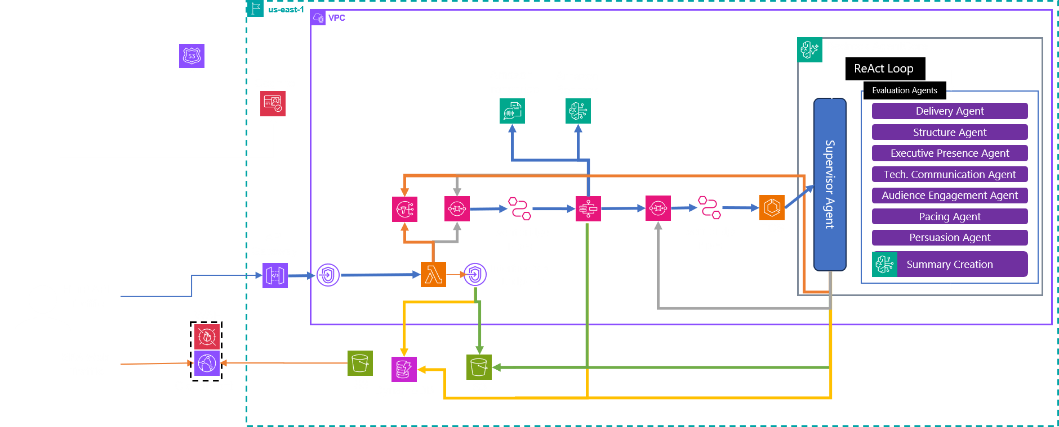
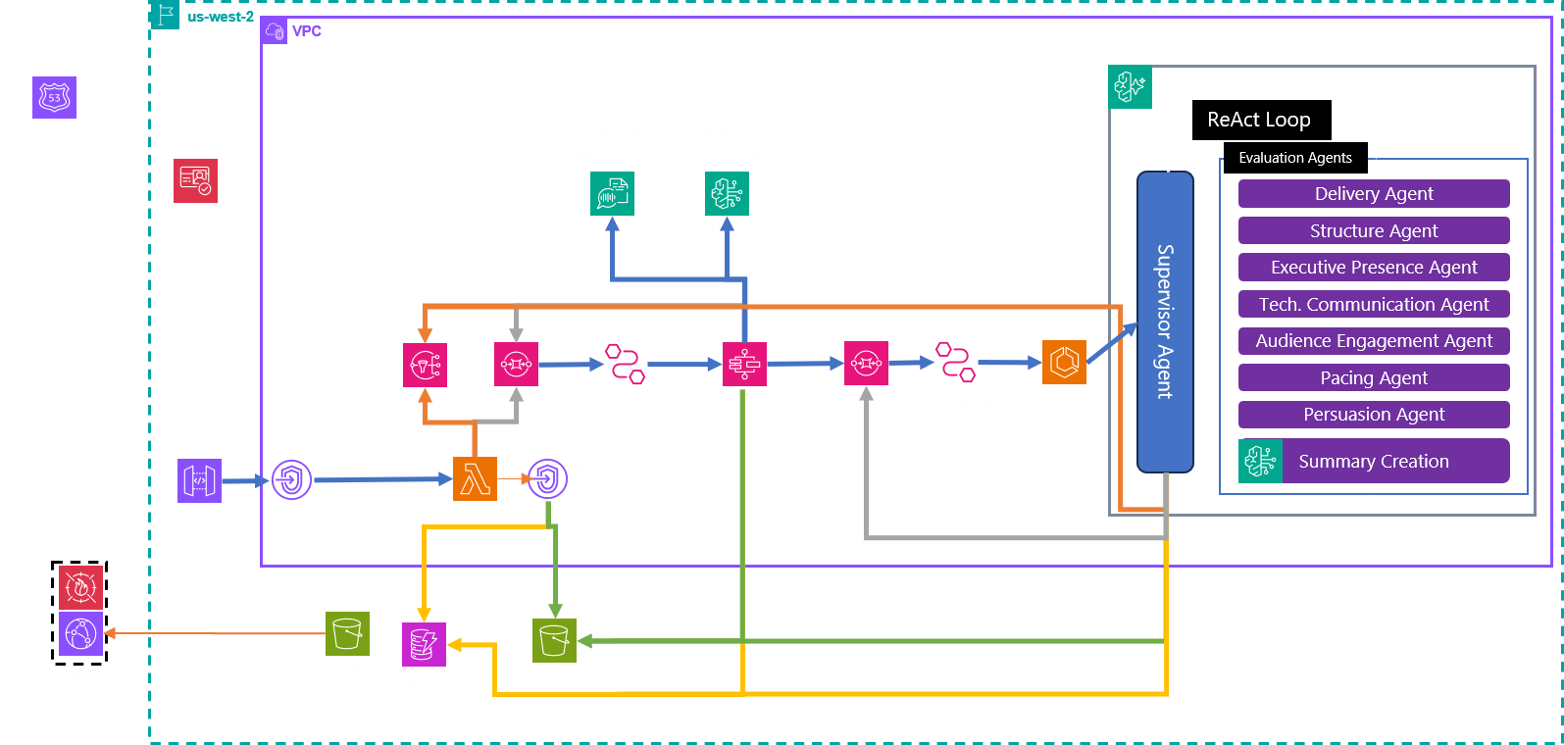
Replication
S3 CRR
&
Dynamo Global Tables

